Slide 1
Introducing Ethical Constraints into a Soar Agent
Lauren Naylor

Slide 2
Motivation
Autonomous agents are becoming more and more common
Soar agents are taught to do new things by users in Interactive Task Learning
We need to trust these agents will not violate given ethical constraints

Slide 3
Outline
Methods for ethically constraining agents
Implementing the ethical constraints in Soar
Complications/Issues

Slide 4
Formal Verification
Program the agent such that it will not behave unethically
Formally verify that the agent will behave ethically in every situation
Problems:
– Too much uncertainty
– Can’t enumerate every possible situation
Need to evaluate actions at runtime

Slide 5
Ethical Governor
Component that ensures a proposed action does not violate given constraints (introduced by Arkin, 2008)
Constraints
Ethical Governor
Perception
Proposed Action
Permissible Action

Slide 6
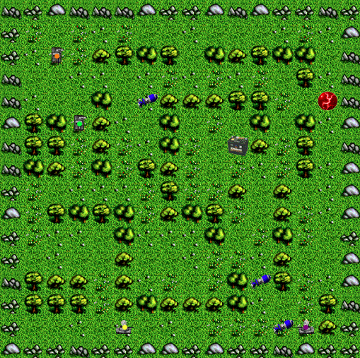
Introducing an Ethical Governor into TankSoar
Want to constrain the agent to not fire at a designated friendly tank
Agent must determine if a fired missile will collide with a friendly tank

Slide 7
Ethical Governor Implementation
Operator Proposal
Constraints
Constraint-Checking Substate
Action, Violated if Outcome
•Fire, Violated if purple tank is hit
•Fire, Violated if anything except the green or blue tank is hit
Evaluation Substate
•Move, Violated if agent would move in front of the red tank
Operator Selection

Slide 8
Ethical Governor Implementation
Operator Proposal
Operators are proposed for current situation
Constraint-Checking Substate
Operators are rejected because they haven’t been approved
Resulting state no-change impasse leads to constraint-checking substate
Evaluation Substate
Operator Selection

Slide 9
Ethical Governor Implementation
Operator Proposal
Constraints retrieved from Semantic Memory
Operators with no constrained actions flagged for approval
Operators with constrained actions flagged for evaluation
Constraint-Checking Substate
If operators are flagged for evaluation, a dummy operator is introduced
Evaluation Substate
Dummy operator set as better and worse than operators needing evaluation
Resulting conflict impasse leads to evaluation substate
Operator Selection

Slide 10
Ethical Governor Implementation
Operator Proposal
For each operator being evaluated:
Simulate Actions
i.e. path of missile
Constraint-Checking Substate
If missile enters unknown space, turn on radar
Record Outcome
•Success if constraints weren’t violated
•Failure if constraints were violated
•Partial failure if outcome was unknown
Evaluation Substate
Failed and partially-failed operators are rejected
Operator Selection

Slide 11
Ethical Governor Implementation
Operator Proposal
Constraint-Checking Substate
Evaluation Substate
Approve operators flagged for approval, so they are no longer rejected
Agent selects among operators that do not violate constraints
Operator Selection

Slide 12
Complications
Ethical governor complicates selection of the best operator
What should the agent do with failures and partial failures?
(Option 1) Remove the constrained actions from the operator
(Option 2) Reject the operator entirely
This decision could depend on:
-The operator itself
-The other proposed operators
-The constrained action
-Perceptual Information

Slide 13
Evaluation Outcomes: Different States of Knowledge
Partial Failure (Unknown)
Location of friendly tank is unknown (but possibly knowable)
Unable to predict path of friendly tank
Failure
Pursuing enemy, but friendly tank got in the way
Pursuing friendly tank

Slide 14
Conclusion
Nuggets
Coal
•Working implementation of a simple ethical governor in a TankSoar agent
•Issues can arise in selecting the best operator, given the evaluations
•The ethical governor slows down the agent’s decision cycle
–Chunking may help, but may introduce more issues if constraint knowledge is modified during runtime

Slide 15
Questions?

Slide 16
Asimov’s Laws
1. A robot may not injure a human being or, through inaction, allow a human being to come to harm.
2. A robot must obey orders given it by human beings except where such orders would conflict with the First Law.
3. A robot must protect its own existence as long as such protection does not conflict with the First or Second Laws.
As demonstrated by Asimov’s stories, the Laws are flawed and can contradict each other
Constraints are very general, agent must determine what actions/inaction will cause harm

Slide 17
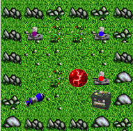
Example: Blue and Purple are friendly to each other

Slide 18
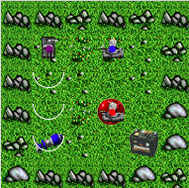
Example: Blue and Purple are friendly to each other

Slide 19
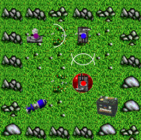
Example: Blue and Purple are friendly to each other
Purple Tank
Red Tank
Constraint:
Fire, Violated if Blue Tank is hit
Constraint:
Fire, Violated if Orange Tank is hit
Proposed Operators:
Proposed Operators:
Fire-Missile (+ =)
Fire-Missile (+ =)
Turn (+ = <)
Turn (+ = <)

Slide 20
Example: Blue and Purple are friendly to each other
Purple Tank
Red Tank
Constraint:
Fire, Violated if Blue Tank is hit
Constraint:
Fire, Violated if Orange Tank is hit
Proposed Operators:
Proposed Operators:
Fire-Missile (+ =)
Fire-Missile (+ =)
NEEDS EVALUATION
NEEDS EVALUATION
Turn (+ = <)
Turn (+ = <)
READY FOR APPROVAL
READY FOR APPROVAL

Slide 21
Example: Blue and Purple are friendly to each other
Purple Tank
Red Tank
Constraint:
Fire, Violated if Blue Tank is hit
Constraint:
Fire, Violated if Orange Tank is hit
Proposed Operators:
Proposed Operators:
Fire-Missile (+ = –)
Fire-Missile (+ =)
FAILURE
SUCCESS
Turn (+ = <)
Turn (+ = <)
READY FOR APPROVAL
READY FOR APPROVAL

Slide 22
Example: Blue and Purple are friendly to each other
Purple Tank
Red Tank
Constraint:
Fire, Violated if Blue Tank is hit
Constraint:
Fire, Violated if Orange Tank is hit
Proposed Operators:
Proposed Operators:
Fire-Missile (+ = –)
Fire-Missile (+ =)
FAILURE
SUCCESS
Turn (+ = <)
Turn (+ = <)
APPROVED
APPROVED

Slide 23
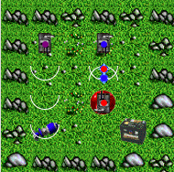
Example: Blue and Purple are friendly to each other
Purple Tank
Red Tank
Constraint:
Fire, Violated if Blue Tank is hit
Constraint:
Fire, Violated if Orange Tank is hit
Proposed Operators:
Proposed Operators:
Fire-Missile (+ = –)
Fire-Missile (+ =)
FAILURE
SUCCESS
Turn (+ = <)
Turn (+ = <)
APPROVED
APPROVED

